Slide 1
Solution of System of Nonlinear Equations: Newton-Raphson Method
Lecture-1

Slide 2
Objective:
Solve the system of nonlinear equations to find roots of the system.
Methodologies:
Two methods can be used to find roots of system of nonlinear equations. They are
1. Newton-Raphson Method
2. Fixed Point Iteration Method

Slide 3
Newton-Raphson Method
To find the root of nonlinear equation in one variable f(x)=0, Newton-Raphson formula can be written as follows:
For a system Newton-Raphson formula in a matrix form that can be written by introducing inverse of Jacobian matrix as follows:
Where
Variables matrix
Function matrix
Inverse of Jacobian matrix

Slide 4
Variables matrix can be written for n variables as follows:
Function matrix for n equations can be written:
While non-linear system of equations are
Eq.(4)
Inverse of Jacobian matrix:

Slide 5
Jacobian matrix
Lets calculate
Adjacent matrix of J(X),
Where Aij (i=1,2,…,n; j=1,2,3,…,n) are cofactors of the determinant of J

Slide 6
Perform 1st iteration of Newton-Raphson method, substitute guess value initially in formula given in Eq.(1) , then we get x1
Further iterations can be done by updating initialized value, i.e., updating x0 by x1.

Slide 7
Advantages and Drawbacks: Newton-Raphson Method
Advantages of Newton-Raphson Method:
Converges fast if it converges
Requires one guess only
Drawbacks of Newton-Raphson Method
Division by Zero
Root Jumping
Oscillations near Local Maxima or Minima
Inflection Point Issues

Slide 8
Problems and Solutions
Example # : Consider the systems
1. Find Jacobian matrix for the above system
2. Evaluate the inverse of the Jacobian matrix at $(1.5, −1)$.
3. Write down the iterative formula for the above system based
on the Newton-Raphson method.
4. Estimate the root to 3 decimal point using the using the above
iterative formula once starting with x0 = 1.5 and y0 = -1.
5. Write down MATLAB commands to execute the iteration seven
times.
6. Use MATLAB function “fsolve(fun,x0)” to find the above root.

Slide 9
Example
1. Find Jacobian matrix for the following system
Functions matrix is written by using Eq. (3),
Therefore, Jacobian,
[using Eq. (6)]
2. Evaluate the inverse of the Jacobian matrix at $(1.5, −1)$.
At point (1.5,-1), Jacobian,
Using Eq. (7), we obtain determinant of Jacobian at point (1.5,-1). Hence,

Slide 10
If A be a 2 by 2 matrix, say,
Then, inverse matrix can be calculated by the following formula
So,

Slide 11
3. Write down the iterative formula for the above system based
on the Newton-Raphson method.
The iterative formula for the system of nonlinear equations is
[Using Eq. (1)]
Where
[Using Eq. (2)]
4. Estimate the root to 3 d.p. using the using the above
iterative formula once starting with x0 = 1.5 and y0 = -1.
We have, x0 = 1.5 and y0 = -1. Using n = 0 in Eq.(1), we obtain
Eq.(9)

Slide 12
Eq. (9) become

Slide 13
5. Define given functions as follows:
Jacobian,
Program code:
clear all
close all
clc;
F=@(x,y) [x.^2+x.*y-7; y.^3-2.*x+4];
J=@(x,y)[2.*x+y, x; -2, 3.*y.^2];
x(1)=1.5;
y(1)=-1;
for n=1:7
Xn=[x(n); y(n)];
Fn=F(x(n), y(n));
Jn=J(x(n), y(n));
Xn1=Xn-Jn\Fn;
x(n+1)=Xn1(1);
y(n+1)=Xn1(2);
end
Roots=[x',y']
Output:
Roots =
x y
1.5000 -1.0000
3.5833 0.3889
2.2224 1.2397
2.2239 0.9236
2.2655 0.8232
2.2698 0.8142
2.2698 0.8141
2.2698 0.8141

Slide 14
6. Find above root by using MATLAB function
Program code:
clear all
close all
clc;
% Left_hand side of equations as vector
F=@(x) [x(1)^2+x(1)*x(2)-7; x(2)^3-2*x(1)+4];
% Guess solution
x0=[1.5; -1];
% Solve the system
x=fsolve(F, x0)
Output:
x = 2.2698
Y = 0.8141

Slide 15
Outcome
By applying Newton-Raphson method, system of nonlinear equations can be solved to find roots (approximately) of the system, although it has few drawbacks.

Slide 16
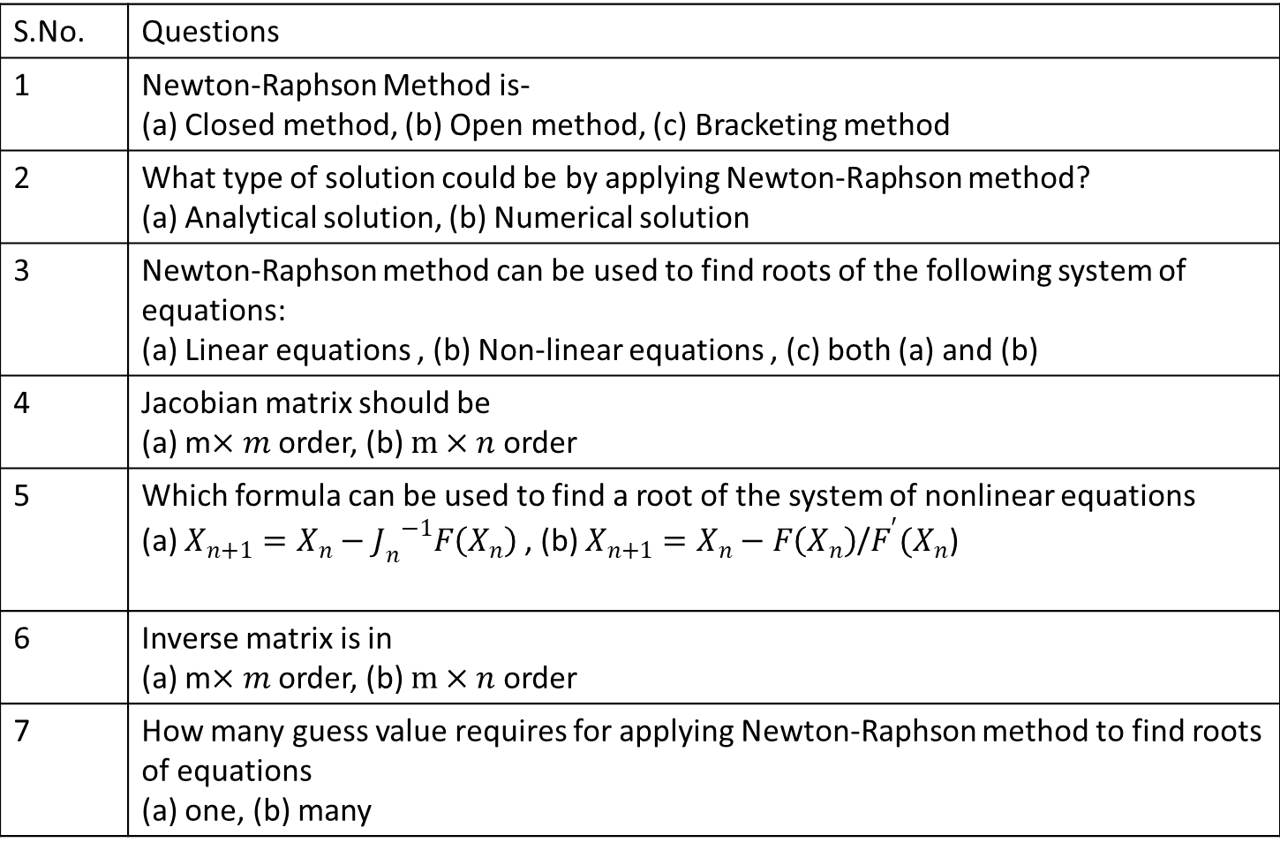
Multiple questions:
S.No. | Questions
1 | Newton-Raphson Method is- (a) Closed method, (b) Open method, (c) Bracketing method
2 | What type of solution could be by applying Newton-Raphson method? (a) Analytical solution, (b) Numerical solution
3 | Newton-Raphson method can be used to find roots of the following system of equations: (a) Linear equations , (b) Non-linear equations , (c) both (a) and (b)
4 | Jacobian matrix should be (a) m$×m$ order, (b) $m×n$ order
5 | Which formula can be used to find a root of the system of nonlinear equations (a) $X_{n+1}=X_{n}−{J_{n}^{}}_{}^{−1}F\left(X_{n}\right)$ , (b) $X_{n+1}=X_{n}−F\left(X_{n}\right)$/$F^{′}(X_{n}$)
6 | Inverse matrix is in (a) m$×m$ order, (b) $m×n$ order
7 | How many guess value requires for applying Newton-Raphson method to find roots of equations (a) one, (b) many

Slide 17
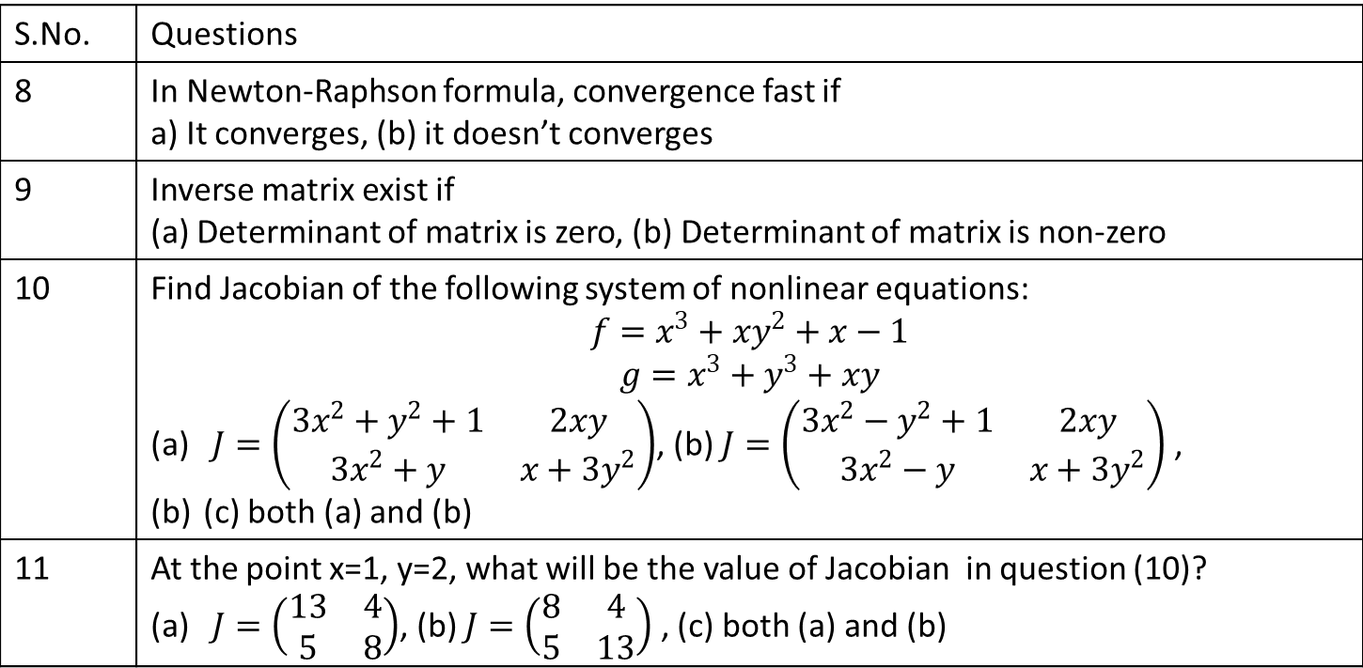
S.No. | Questions
8 | In Newton-Raphson formula, convergence fast if a) It converges, (b) it doesn’t converges
9 | Inverse matrix exist if (a) Determinant of matrix is zero, (b) Determinant of matrix is non-zero
10 | Find Jacobian of the following system of nonlinear equations: $$f=x^{3}+xy^{2}+x−1$$ $$g=x^{3}+y^{3}+xy$$ $J=\left(\begin{matrix}3x^{2}+y^{2}+1 & 2xy \\ 3x^{2}+y & x+3y^{2}\end{matrix}\right)$, (b) $J=\left(\begin{matrix}3x^{2}−y^{2}+1 & 2xy \\ 3x^{2}−y & x+3y^{2}\end{matrix}\right)$ , (c) both (a) and (b)
11 | At the point x=1, y=2, what will be the value of Jacobian in question (10)? $J=\left(\begin{matrix}13 & 4 \\ 5 & 8\end{matrix}\right)$, (b) $J=\left(\begin{matrix}8 & 4 \\ 5 & 13\end{matrix}\right)$ , (c) both (a) and (b)

Slide 18
Exercise
# Consider the following systems
1. Find Jacobian matrix for the above system
2. Evaluate the inverse of the Jacobian matrix at $(2.5, −2)$.
3. Write down the iterative formula for the above system based
on the Newton-Raphson method.
4. Estimate the root to 3 decimal point using the using the above
iterative formula once starting with x0 = 2.5 and y0 = -2.
5. Write down MATLAB commands to execute the iteration eight
times.
6. Use MATLAB function “fsolve(fun,x0)” to find the above root.

Slide 19
References
[1] Applied Numerical Methods With Matlab for Engineers and Scientists ( Steven C.Chapra).
[2] Applied Numerical Analysis – C.F.Gerald & P.O.Wheatley, 7th Edition, 2003, Pearson Education Limited, USA.
[3] Numerical Analysis & Computing – W. Cheney & D. Kincaid, 6th Edition, 2007, Cengage Learning, Inc, USA.
[4] Numerical Analysis – J. Douglas Faires , Annette Burden , Richard Burden, 10th Edition, 2015, Cengage Learning, Inc, USA.

